Slide 1
SSH – Secure Shell

Slide 2
Communication Over the Internet
What type of guarantees do we want?
Confidentiality
Message secrecy
Data integrity
Message consistency
Authentication
Identity confirmation
Authorization
Specifying access rights to resources

Slide 3
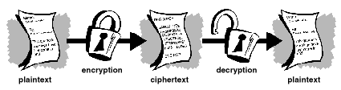
Cryptography
●
Plaintext – Actual message
●
Ciphertext – Encrypted message (unreadable gibberish)
●
Encryption – Going from plaintext to ciphertext
●
Decryption – Going from ciphertext to plaintext
●
Secret key
–
Part of the mathematical function used to encrypt/decrypt. Good key makes it hard to get back plaintext from ciphertext
–
Image Source: gpgtools.org

Slide 4
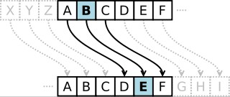
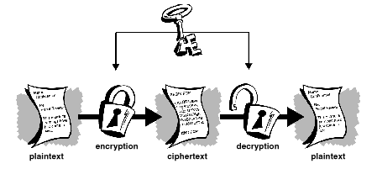
Symmetric-key Encrption
●
Same secret key used for encryption and decryption
●
Example : Data Encryption Standard (DES)
●
Caesar's cipher
–
Map the alphabet to a shifted version
●
ABCDEFGHIJKLMNOPQRSTUVWXYZ DEFGHIJKLMNOPQRSTUVWXYZABC
●
–
Plaintext – SECRET. Ciphertext – VHFUHW Key is 3 (number of shifts of the alphabet)
–
●
Key distribution is a problem
Image Source: wikipedia
–
The secret key has to be delivered in a safe way to the recipient Chance of key being compromised
–
Image Source: gpgtools.org

Slide 5
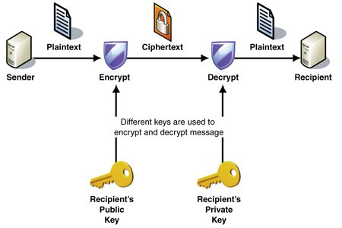
Public-key Encryption (Asymmetric)
●
Uses a pair of keys for encryption
–
Public key – Published and known to everyone
Private key – Secret key known only to the owner
–
●
Encryption
–
Use public key to encrypt messages
Anyone can encrypt message, but they cannot decrypt the ciphertext
–
●
Decryption
–
Use private key to decrypt messages
●
Example : RSA – Rivest, Shamir & Adleman
–
Property used - Difficulty of factoring large
integers to prime numbers
N = p * q (3233 = 61 * 53)
N is a large integer and p, q are prime numbers N is part of the public key
http://en.wikipedia.org/wiki/RSA_Factoring_Challenge
–
–
Image Source: MSDN
–
–

Slide 6
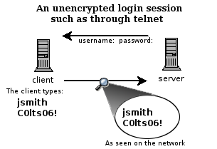
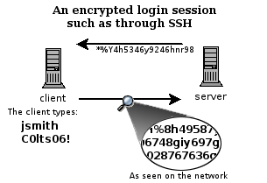
Secure Shell (SSH)
●
Telnet
–
Remote access Not encrypted
Packet sniffers can intercept sensitive information (username/password)
–
–
●
SSH
–
Run processes remotely Encrypted session
Session key (secret key) used for encryption during the session
–
–
Image Source: suso.com

Slide 7
Secure Shell (SSH) – Client Authentication
●
Password login
– ssh username@ugrad.seas.ucla.edu
●
Passwordless login with keys
Use private/public keys for authentication (Server and Client authentication)
– ssh-keygen
–
●
Passphrase (longer version of a password / more secure) Passphrase for protecting the private key
Passphrase needed whenever the keys are accessed
●
●
–
ssh-copy-id username@ugrad.seas.ucla.edu
●
Copies the public key to the server (~/.ssh/authorized_keys)
–
Login without password
●
ssh username@ugrad.seas.ucla.edu
Run scripts/commands on the remote machine
– ssh username@ugrad.seas.ucla.edu ls
But you need to provide the passphrase to use the private key
●
●

Slide 8
Secure Shell (SSH) – Client Authentication
●
Passphrase-less authentication
ssh-agent - Authentication agent Manages private key identities for SSH
To avoid entering the passphrase whenever the key is used
ssh-add
–
–
–
–
●
Registers the private key with the agent Passphrase asked only once
ssh will ask the ssh-agent whenever the private keys are needed
●
●

Slide 9
Account Administration
Install OpenSSH (Should be done on both server and client)
$ sudo
$ sudo
$ sudo
apt-get apt-get apt-get
update
install openssh-server install openssh-client
Server
$ sudo useradd
$ sudo passwd <UserName>
– $
– $
– $
– $
– $
– $
-d /home/<username> -m <UserName>
cd /home/<username>
sudo sudo sudo
mkdir chown chmod
.ssh
-R <username> .ssh 700 .ssh
ifconfig (This will give you the IP address of the server. Give this to your partner.)
ps aux | grep ssh (This should show a process named 'sshd' – the ssh daemon/server)
Client
$ ssh-keygen
$ ping server_ip_addr (Just to check if the server responds)
$ ssh-copy-id -i <UserName>@server_ip_addr
$ ssh-add
$ ssh -X <UserName>@server_ip_addr
$ xterm
$ firefox

Slide 10
X Session forwarding
●
X is the windowing system for GUI apps on Linux
You want to run such apps remotely, but the GUI should show up on the local machine
●
–
ssh -X username@ugrad.seas.ucla.edu gedit
gimp
–
–

Slide 11
Secure copy (scp)
●
Based on Secure Shell (ssh)
Used for transferring files between hosts in a secure way (encrypted) Usage similar to cp
– scp [source] [destination]
Transferring to remote host
●
●
●
– scp /home/username/doc.txt username@ugrad.seas.ucla.edu:/home/user/docs/
●
Transferring from remote host
– scp username@ugrad.seas.ucla.edu:/home/user/docs/foo.txt /home/username

Slide 12
How to Check IP Addresses
$ ifconfig
configure or display the current network interface configuration information (IP address, etc.)
$ ping <ip_addr>(packet internet groper)
Test the reachability of a host on an IP network
Measure round-trip time for messages sent from a source to a destination computer
Example: $ ping 192.168.0.1, $ ping google.com

Slide 13
Lab 6
Securely log in to each others’ computers
Use ssh (OpenSSH)
Use key-based authentication
Generate key pairs
Make logins convenient
type your passphrase once and be able to use ssh to connect to any other host without typing any passwords or passphrases
Use port forwarding to run a command on a remote host that displays on your host

